Slide 1
Lecture 12: Virtualizing Memory – Swapping

Slide 2
The Course Organization (Bottom-up)
Race Conditions, Lock/Semaphore
Concurrency
Thread
Memory Management
HW#4
Virtualization
Process and CPU Scheduling
HW#3
IO Devices and Storage
HW#2
&
Project
Persistence
File System
System Calls (User-level Programming)
HW#1

Slide 3
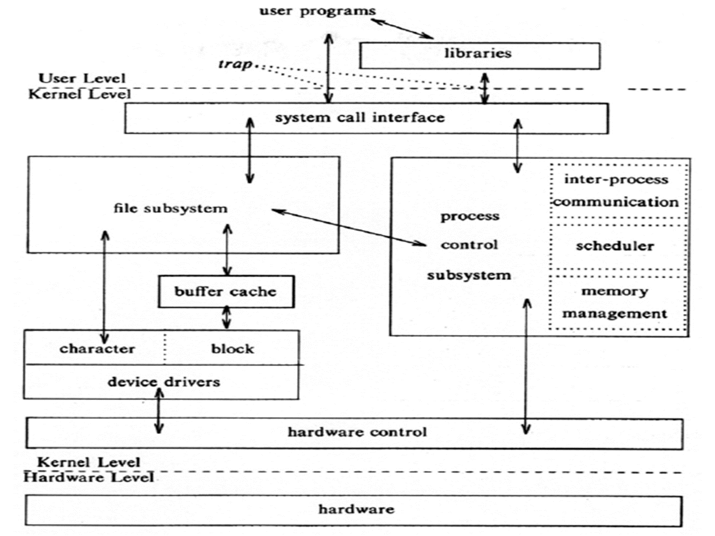
OS – Resource management via virtualization
OS provides services via System Call (typically a few hundred) to run process, access memory/devices/files, etc.
The OS manages resources such as CPU, memory and disk via virtualization.
many programs to run (processes) → Sharing the CPU
many processes to concurrently access their own instructions and data → Sharing memory
many processes to access devices → Sharing disks
The Design Of The Unix Operating System (Maurice Bach, 1986)

Slide 4
Beyond Physical Memory: Mechanisms
Require an additional level in the memory hierarchy.
OS needs a place to stash away portions of address space that currently aren’t in great demand.
In modern systems, this role is usually served by a hard disk drive
Registers
Cache
Main Memory
Mass Storage( hard disk, tape, etc...)
Memory Hierarchy in modern system

Slide 5
Single large address for a process
Always need to first arrange for the code or data to be in memory before calling a function or accessing data.
Multiple processes rather than a single process
The addition of swap space allows the OS to support the illusion of a large virtual memory for multiple concurrently-running processes

Slide 6
Swap Space
Reserve some space on the disk for moving pages back and forth.
OS needs to remember page addresses in the swap space, in page-sized unit
PFN 0
PFN 1
PFN 2
PFN 3
Proc 0 [VPN 0] | Proc 1 [VPN 2] | Proc 1 [VPN 3] | Proc 2 [VPN 0]
Physical
Memory
Block 1
Block 2
Block 3
Block 4
Block 5
Block 6
Block 0
Block 7
Swap
Space
Proc 0 [VPN 1] | Proc 0 [VPN 2] | [Free] | Proc 1 [VPN 0] | Proc 1 [VPN 1] | Proc 3 [VPN 0] | Proc 2 [VPN 1] | Proc 3 [VPN 1]
Physical Memory and Swap Space

Slide 7
What If Memory Is Full ?
The OS moves out pages to make room for the new pages
The process of picking a page to kick out, or replace is known as page-replacement policy
Add some machinery in the system to support swapping pages to and from the disk.
When the hardware looks in the PTE, it may find that the page is not present in physical memory.
Value | Meaning
1 | page is present in physical memory
0 | The page is not in memory but rather on disk.

Slide 8
The Page Fault
Accessing page that is not in physical memory.
If a page is not present and has been swapped disk, the OS needs to swap the page into memory in order to service the page fault.
Value | Meaning
1 | page is present in physical memory
0 | The page is not in memory but rather on disk.

Slide 9
Page Fault Control Flow
PTE used for data such as the PFN of the page for a disk address.
Operating System
3. Issue disk read based on the address information from the page table or PTE.
Secondary Storage
1. Reference
2.Trap
Load M
 | i
6. reinstruction
Page Frame
Page Frame
Page Table
...
4. Get the page
5. Reset Page Table.
Page Frame
Page Frame
Virtual Address
When the OS receives a page fault, it looks in the PTE and issues the request to disk.

Slide 10
Page Fault Control Flow – Hardware
1: VPN = (VirtualAddress & VPN_MASK) >> SHIFT
2: (Success, TlbEntry) = TLB_Lookup(VPN)
3: if (Success == True) // TLB Hit
4: if (CanAccess(TlbEntry.ProtectBits) == True)
5: Offset = VirtualAddress & OFFSET_MASK
6: PhysAddr = (TlbEntry.PFN << SHIFT) | Offset
7: Register = AccessMemory(PhysAddr)
8: else RaiseException(PROTECTION_FAULT)
VPN-Virtual Page Number PFN – Physical Frame Number

Slide 11
Page Fault Control Flow – Hardware
9: else // TLB Miss
10: PTEAddr = PTBR + (VPN * sizeof(PTE))
11: PTE = AccessMemory(PTEAddr)
12: if (PTE.Valid == False)
13: RaiseException(SEGMENTATION_FAULT)
14: else
15: if (CanAccess(PTE.ProtectBits) == False)
16: RaiseException(PROTECTION_FAULT)
17: else if (PTE.Present == True)
18: // assuming hardware-managed TLB
19: TLB_Insert(VPN, PTE.PFN, PTE.ProtectBits)
20: RetryInstruction()
21: else if (PTE.Present == False)
22: RaiseException(PAGE_FAULT)
VPN-Virtual Page Number PFN – Physical Frame Number
PTE – Page Table Entry PTBR – Page Table Base Register

Slide 12
Page Fault Control Flow – Software
1: PFN = FindFreePhysicalPage()
2: if (PFN == -1) // no free page found
3: PFN = EvictPage() // run replacement algorithm
4: DiskRead(PTE.DiskAddr, pfn) // sleep (waiting for I/O)
5: PTE.present = True // update page table with present
6: PTE.PFN = PFN // bit and translation (PFN)
7: RetryInstruction() // retry instruction
The OS must find a physical frame for the soon-be-faulted-in page to reside within.
If there is no such page, waiting for the replacement algorithm to run and kick some pages out of memory.

Slide 13
When Replacements Really Occur
OS waits until memory is entirely full, and only then replaces a page to make room for some other page – Unrealistic
OS should proactively keep a small portion of memory free more proactively.
Swap Daemon, Page Daemon
There are fewer than LW pages available, a background thread that is responsible for freeing memory runs.
The thread evicts pages until there are HW pages available.
(LW – Low Watermark; HW – High Watermark)

Slide 14
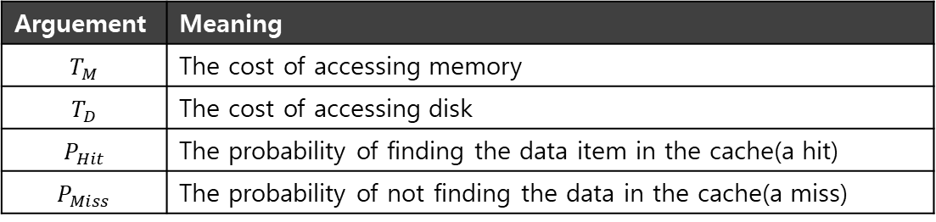

Replacement Policy (Which pages to evict from memory)
Goal in picking a replacement policy cache is to minimize the number of misses.
The number of hits and misses let us calculate the average memory access time(AMAT).
LRU (Least Recently Used) – A common approach (based on the history)
Replaces the least-recently-used page.
$$AMAT=T_{M}+(P_{Miss}∗T_{D})$$
Arguement | Meaning
$$T_{M}$$ | The cost of accessing memory
$$T_{D}$$ | The cost of accessing disk
$$P_{Hit}$$ | The probability of finding the data item in the cache(a hit)
$$P_{Miss}$$ | The probability of not finding the data in the cache(a miss)

Slide 15
Prefetching
The OS predicts that a page will be used, and thus brings it in beforehand.
Page 1 is brought into memory
Page 3
Page 4
Page 5
…
Page n
Physical Memory
Page 2
…
Page 1
Page 3
Page 4
Secondary
Storage
Page 2 likely soon be accessed and
thus should be brought into memory too

Slide 16
Clustering, Grouping
Collect a number of pending writes together in memory and write them to disk in one write.
Perform a single large write more efficiently than many small ones.
Pending writes
Page 1
Page 2
Page 3
Page 4
Page 5
…
Page n
Physical Memory
write in one write
Page 2
…
Page 1
Page 3
Page 4
Secondary
Storage

Slide 17
Thrashing
Memory is oversubscribed and the memory demand of the set of running processes exceeds the available physical memory.
Decide not to run a subset of processes.
Reduced set of processes working sets fit in memory.
CPU
Utilization
Trashing
Degree of multiprogramming

Slide 18
Summary
Swapping
Reserve some space on the disk for moving pages back and forth.
The OS moves out pages to make room for the new pages when there is not enough memory space
Page fault occurs when accessing a page not in memory but in the swap area
Page Replacing
When to replace: LW/HW eviction
How to replace: LRU
Next: Concurrency

